Slide 1



Iterators and Comparators
Java OOP
Advanced
SoftUni Team
Technical Trainers
Software University
http://softuni.bg

Slide 2

Table of Contents
Iterators
Ordinary Iterator
ListIterator
Comparators
Comparable

Slide 3
Questions
sli.do #7718

Slide 4

Iterator
Notes:
An iterator is an object whose job is to move and select elements from a collection.
The client programmer is not knowing how this is achieved, but he knows the collection is iterated.
The iterator is a lightweight object:
- Object that is cheap to create

Slide 5
Iterator
Why do we need it?

Slide 6

Notes:
Example:
Let’s assume, we have an array. It is easy to be iterated. We start from index 0 and iterate till its end.

Slide 7

Notes:
Let’s assume we have a Linked list. It’s not so simple to iterate through the list.
We need some help. Since the client programmer
does not need to know how exactly the collection is iterated,
we achieve this through the iterators.

Slide 8

Notes:
Our third example is a library. How do we iterate it? Where do we start from? Where is its end?
All that questions, we get answered by the iterators. Not literally of course.

Slide 9
Example
List<Integer> numbers = new ArrayList<>(); Iterator<Integer> iterator = numbers.iterator(); boolean hasNext = iterator.hasNext(); Integer nextInt = iterator.next();

Slide 10
Iterator
How do we insert elements in collections?

Slide 11
Iterator
… and how do we fetch them out?
Notes:
With an Iterator, you don’t need to worry about the number of elements in the container.
That’s taken care of for you by hasNext( ) and next( ).

Slide 12
Custom Iterator
public class GradesIterator implements Iterator<Integer> { private int currentIndex = 0; private Integer[] grades = {2,6,6}; @Override public boolean hasNext() { return currentIndex < array.length; } @Override public Integer next() { if (this.hasNext()) { return array[currentIndex++]; } throw new NoSuchElementException(); } }
Notes:
Another Example:
public class Grades implements Iterable<Integer> { private Integer[] grades = {2, 3, 6}; @Override public Iterator<Integer> iterator() { GradesIterator iterator = new GradesIterator(); return iterator; } @Override public void forEach(Consumer<? super Integer> action) { action.accept(iterator().next()); } class GradesIterator implements Iterator { int currentIndex = 0; @Override public boolean hasNext() { return currentIndex < grades.length; } @Override public Integer next() { if (this.hasNext()) { return grades[currentIndex++]; } throw new NoSuchElementException(); } } }

Slide 13

Conventions

Slide 14

Laziness
Notes:
Iterators are lazy. Their task is to iterate a collection, only when it is needed. This characteristic could be classified as laziness.

Slide 15

Demo

Slide 16

ListIterator
Notes:
The ListIterator is more powerful subtype of Iterator, that is produced only by List classes.
Its true power is that it could iterate onwards and backwards. We are capable of iterating in both
directions. Another powerful option is to produce the indexes of the next and the previous elements.

Slide 17
Example
List<Integer> integers = new ArrayList<>(); ListIterator<Integer> iterator = integers.listIterator();
int previous = iterator.previous(); boolean hasPrevious = iterator.hasPrevious(); int previousIndex = iterator.previousIndex();

Slide 18
Demo

Slide 19

Exercises in Class

Slide 20
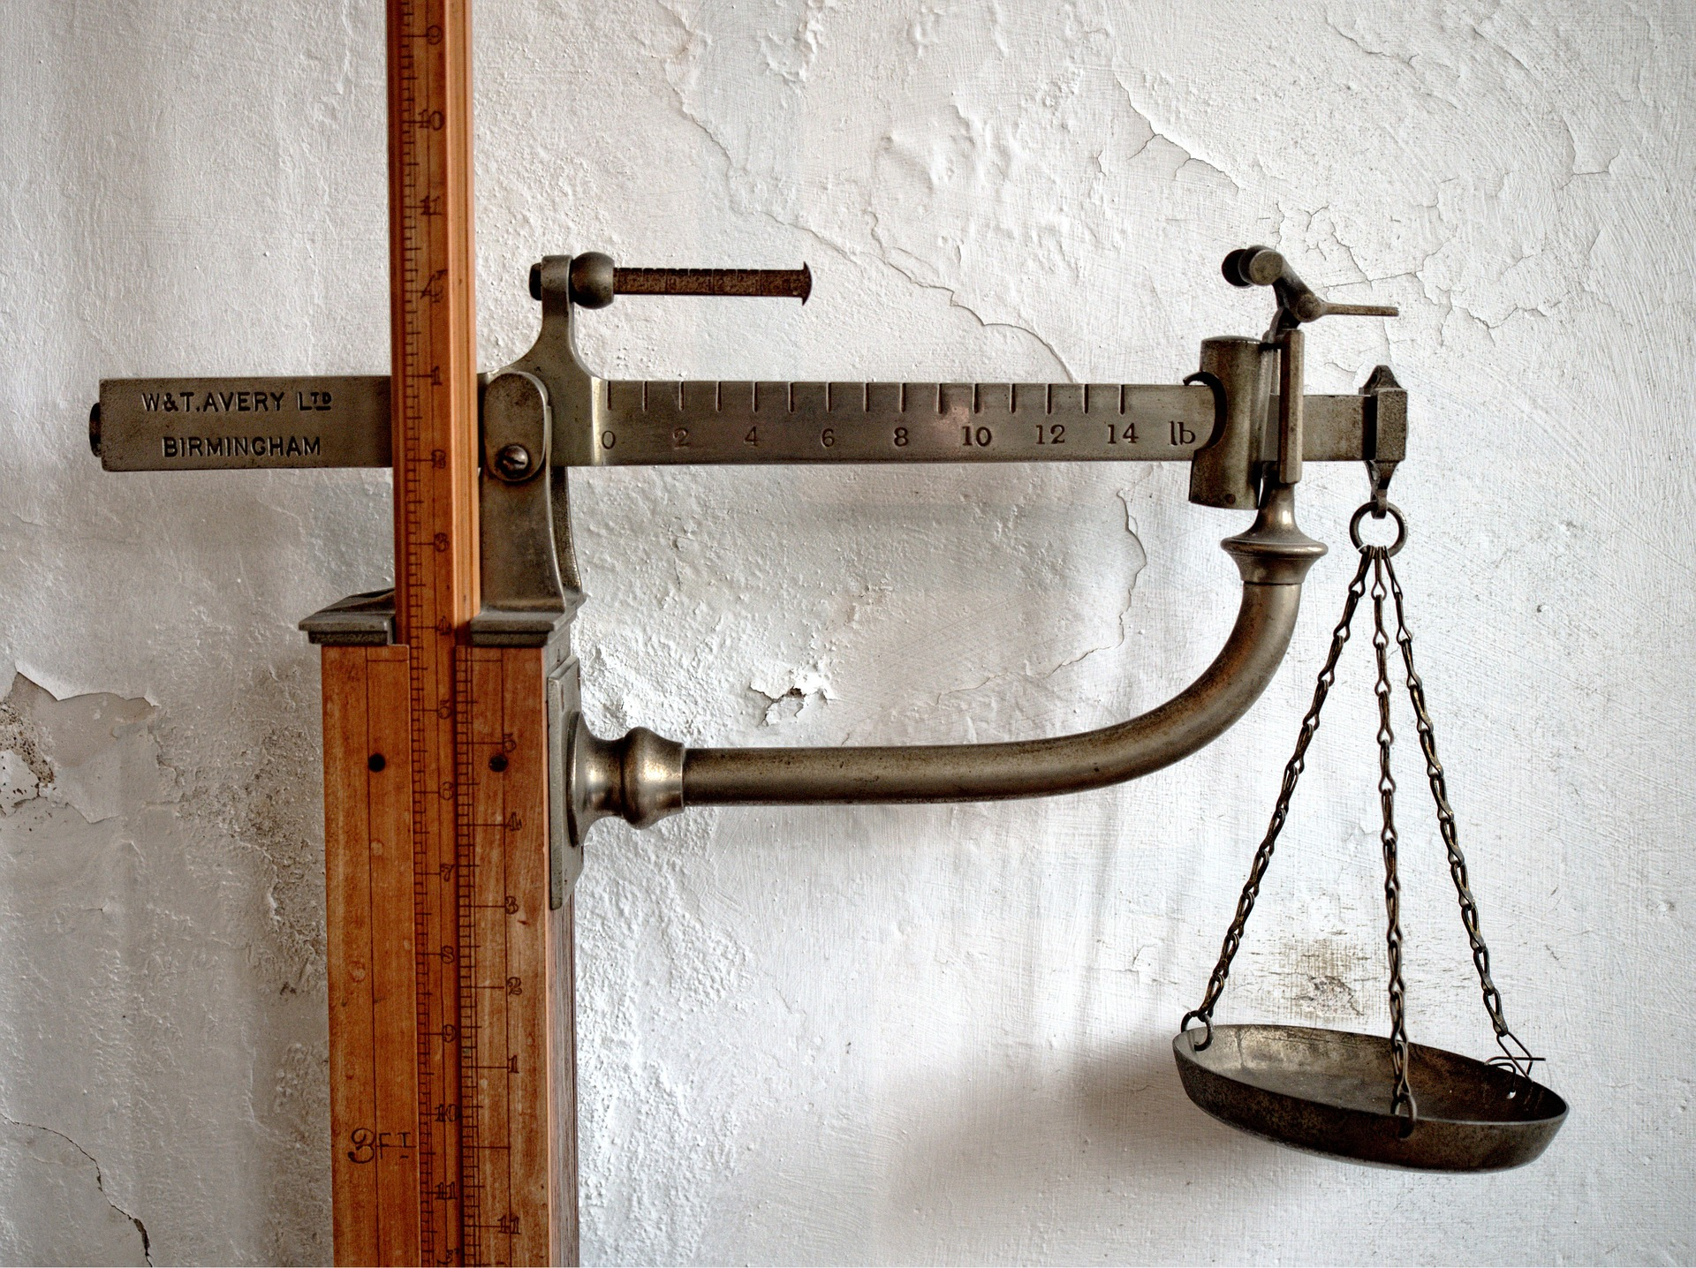
Comparator
Notes:
Java has two ways to compare objects. The first is with “natural” comparison of the objects by the method, inherited from the
interface – Comparable. This is a very simple interface with a single method, compareTo( ). It takes another object of the same type
and produces a negative value if the current object is less than the one passed as argument, zero if it is equal and positive value
if the current object is greater than the argument.
The second one is by using the “==“ signs. But its drawback is it compares the references, but this is not the result we are looking for in many situations.

Slide 21
Comparator
Why do we need it?

Slide 22


Slide 23
Overriding compareTo()
@Override public int compareTo(Object o) { // compare logic }

Slide 24
Comparator
How to implement it in our objects?

Slide 25
Example
public class Cat implements Comparable<Cat> { private String name; // Constructor // Properties @Override public int compareTo(Cat otherCat) { this.getName.compareTo(otherCat.getName); }
}

Slide 26
Demo

Slide 27
Exercises in Class

Slide 28

Summary
Why do we need
Iterator
Comparator

Slide 29








Iterator And Comparator
https://softuni.bg/java-basics-oop

Slide 30

License
This course (slides, examples, demos, videos, homework, etc.) is licensed under the "Creative Commons Attribution-NonCommercial-ShareAlike 4.0 International" license
Attribution: this work may contain portions from
"Fundamentals of Computer Programming with Java" book by Svetlin Nakov & Co. under CC-BY-SA license
"OOP" course by Telerik Academy under CC-BY-NC-SA license

Slide 31






Free Trainings @ Software University
Software University Foundation – softuni.org
Software University – High-Quality Education, Profession and Job for Software Developers
softuni.bg
Software University @ Facebook
facebook.com/SoftwareUniversity
Software University @ YouTube
youtube.com/SoftwareUniversity
Software University Forums – forum.softuni.bg

